Slide 1
What is Communication?
The imparting or exchanging of information by speaking, writing or using some other medium is called communication.
The word ‘communication’ comes from the Latin word commūnicāre, meaning ‘to share’.
Parts of Communication
Communication has three important parts:
Transmitting—The sender transmits the message through one medium or another.
Listening— The receiver listens or understands the message.
Feedback—The receiver conveys their understanding of the message to the sender in the form of feedback to complete the communication cycle.
Elements of Communication
The various elements of a communication cycle are:
Sender: the person beginning the communication.
Message: the information that the sender wants to convey.
Channel: the means by which the information is sent.
Receiver: the person to whom the message is sent.
Feedback: the receiver’s acknowledgement and response to the message.

Slide 2
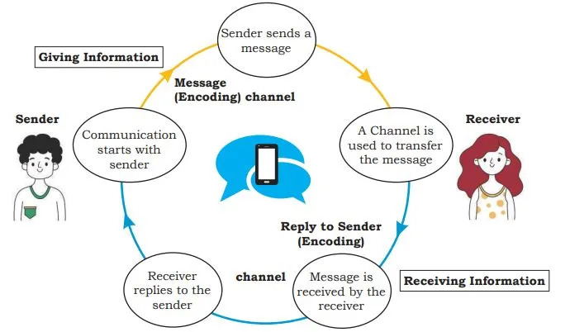
Communication cycle

Slide 3
Methods of Communication
Face-to-face:-There is nothing better than face-to-face communication. It helps the message to be understood clearly and quickly.
E-mail:- This method can be used to communicate quickly with one or many individuals in various locations
Notices/Posters:- It is effective when the same message has to go out to a large group of people
Business Meetings:- Communication during business meetings at an organisation are generally addressed to a group of people.
Other Methods:- There can be various other methods like social networks, message, phone call for communication, newsletter, blog, etc

Slide 4
What is Verbal Communication? Verbal communication includes sounds, words, language, and speech. Speaking is one of the most effective and commonly used way of communicating.
Type of Verbal Communication | Description
Interpersonal Communication | This form of communication takes place between two individuals
Written Communication | This form of communication involves writing words. It can be letters, circulars, reports, manuals, SMS, social media chats, etc
Small Group Communication | This type of communication takes place when there are more than two people involved. Examples 1. Press conferences 2. Board meetings
Public Communication | This type of communication takes place when one individual addresses a large gathering. Example 1. Election campaigns 2. Public speeches by dignitaries

Slide 5
Advantages of Verbal Communication
It is an easy mode of communication.
It also enables you to keep changing your interaction as per the other person’s response.
Disadvantages of Verbal Communication
Verbal communication depends on written words, so sometimes the meanings can be confusing and difficult to understand if the right words are not used.
What is non-Verbal Communication?
Non-verbal communication is the expression or exchange of information or messages without using any spoken or written word.
In our day-to-day communication
55% communication is done using body movements, face, arms, etc.
38% communication is done using voice, tone, pauses, etc.
Only 7% communication is done using words.

Slide 6
Non-Verbal Communication | Example
Gestures | 1. Raising a hand to greet or say goodbye 2. Pointing your finger at someone
Expressions | 1. Smiling when you are happy 2. Making a sad face when you are sad
Body Language | Postures by which attitudes and feelings are communicated.

Slide 7
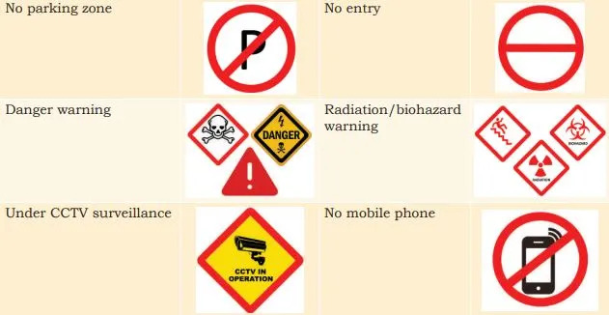
What is Visual Communication?
Visual communication proves to be effective since it involves interchanging messages only through images or pictures
Examples of Visual Communication

Slide 8
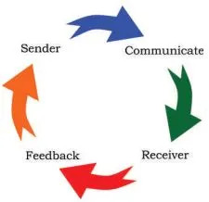
What is Feedback in Communication Cycle?
Feedback is an important part of the communication cycle. A sender sends information and the receiver provides feedback on the received message. Feedback can be positive or negative. A good feedback is always
Specific
Helpful
Kind

Slide 9
Types of Feedback
Types of Feedback | Examples
Positive Feedback | 1. I noticed you finished the work perfectly. Great job! 2. I really appreciate you taking that call. Can you please also share the details?
Negative Feedback | 1. You keep forgetting to smile at the hotel guests when you talk to them. 2. You take really long to reply to e-mails! Are you always so busy?
No Feedback | It is also a feedback in itself which indicates disagreement of ideas.

Slide 10
Importance of Feedback
It validates effective listening
It motivates.
It boosts learning
It improves performance
7Cs of Effective Communication
All the methods of communication can only be effective if we follow the basic principles of professional communication skills.
These can be abbreviated as 7 Cs
Clear : Be clear about what do you want to say.
Concise : Use simple and required words for communication.
Concrete : Use exact words and facts.
Correct : Use correct spelling and grammar.
Coherent : Words should make sense and relate to the main topic.
Complete : Should include all the required information.
Courteous : Be respectful, friendly and honest.

Slide 11
Barriers to Effective Communication
Some common barriers to effective communication include:
1. Physical Barriers : Physical barrier is the environmental and natural condition that act as a barrier in communication. Not able to see gestures, posture can make communication less effective. For example, text messages are often less effective than face-to-face communication.
2. Linguistic Barriers : The inability to communicate using a language is known as language barrier to communication. It is the most common communication barriers.
3. Interpersonal Barriers : Barriers to interpersonal communication occur when the sender’s message is received differently from how it was intended. Stage fear, lack of will to communicate can create interpersonal barriers to communication.
4. Organisational Barriers : Organisations are designed on the basis of formal hierarchical structures which affect the free flow of communication in organisations. for example Superior-subordinate relationships in a formal organisational structure can be a barrier to free flow of communication.
5. Cultural Barriers : Cultural barriers is when people of different cultures are unable to understand each other’s customs, resulting in facing inconveniences and difficulties in communication.

Slide 12
Ways to overcome Barriers to Effective Communication.
There are many ways to overcome barriers to effective communication, some of them are listed below.
Use simple language
Do not form assumptions on culture, religion or geography
Try to communicate in person as much as possible
Use visuals
Take help of a translator to overcome differences in language
Be respectful of other’s opinions.

Slide 13
Writing Skills
Writing skills are part of verbal communication and include e-mails, letters, notes, articles, SMS/chat, blogs, etc. In all these forms of written communication, we use sentences to express ourselves.
Basic Writing Skills
Basic Writing Skills are as follows
1. Sentence : A sentence is a group of words that communicates a complete thought. A sentence must contain a subject and a verb. There are three types of sentences.
Simple sentence : A simple sentence is one independent clause that has a subject and a verb and expresses a complete thought.
Examples • I am out of paper for the printer. • Will you help me with the math homework?

Slide 14
Compound Sentence : A compound sentence allows us to share a lot of information by combining two or more related thoughts into one sentence.
Example I drove to the office, and then I walked to the cabin
Complex Sentence : A complex sentence is a sentence that combines one independent clause with at least one dependent clause.
Example •Although Rohan had some doubts, he found the courses very useful. •Computers have come a long way since they first came on the market.
NOTE : Sentences can also be categorised as Active Sentence and Passive Sentence. Sentences where the subject does an action are known to be in the Active voice, whereas sentences in which the subject receives an action are known to be in the Passive voice.

Slide 15
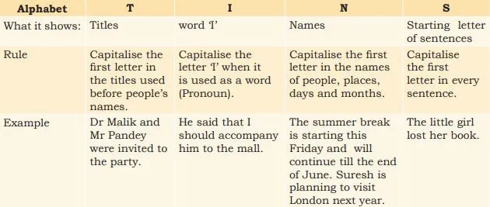
Capitalisation :
We know that all sentences begin with capital letters. However, there are certain other points in a sentence where we should use capital letters. ‘TINS’is a set of simple rules that help you capitalise words correctly.

